Slide 1
Classification of Indian Birds
Arijeet Mondal(24M0812)
Tejas Sanjay Shinde(24M0827)
Gyara Pragathi(24M0819)
Sejal Bhaulal Kadamdhad(24M0806)

Slide 2
Task Description
Objective: Classifying 25 distinct Indian bird species using machine learning techniques.
Goal: Achieve high accuracy in bird species classification from images

Slide 3
Dataset Used
The dataset that we have used is Indian-Birds-Species-Image-Classification.
It consist of 25 bird species found in India
Each species has 1,500 images in the dataset.
The dataset contains a total of 37,500 images split into train and validation sets in an 80:20 ratio, with 30,000 images in the training set and 7,500 images in the validation set.

Slide 4
Preprocessing Steps
Created pandas data frame with image path and their corresponding bird name.
Label encoded the images (0 to 24).
Split the data into train, test and validation sets with the sizes 64%, 16% and 20% where each set has equal number of samples for each label.
Passed the training data through an augmentation layer which randomly flips and resizes the images.

Slide 5
Techniques and Models
Training a full neural network from scratch is time consuming. So, we used some pretrained CNNs and applied two layers on it. We used a variety a pretrained CNNs and showed their results.
Models:
ResNet 50 (Trainable params: 1,186,841)
EfficientNet V2 B0 (Trainable params: 793,625)
MobileNet V2 (Trainable params: 793,625)
Vision Transformer (Trainable params: 531,481)
And lastly ensemble all the above models with averaging (geometric mean).

Slide 6
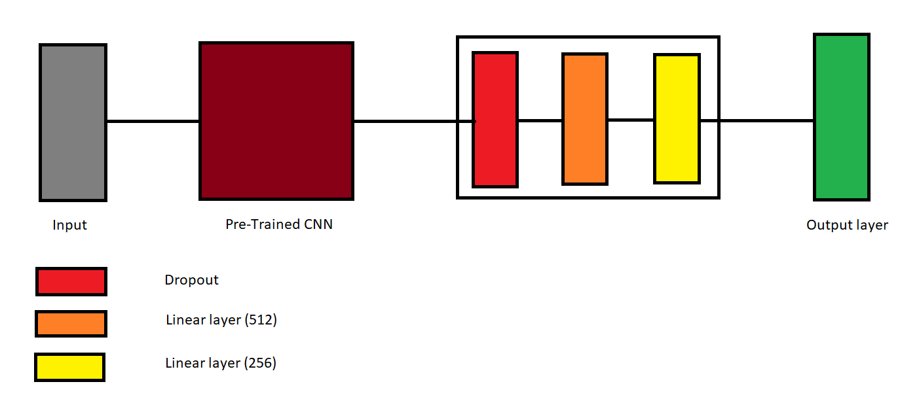
Our Model Architecture
Initialization : GlorotNormal (Xavier initialization)
Optimizer : Adam
Learning Rate : 0.001
Loss Function : Categorical Cross Entropy Loss
Epochs : 5 Batch Size : 32
Callbacks : EarlyStopping & ReduceLROnPlateau

Slide 7
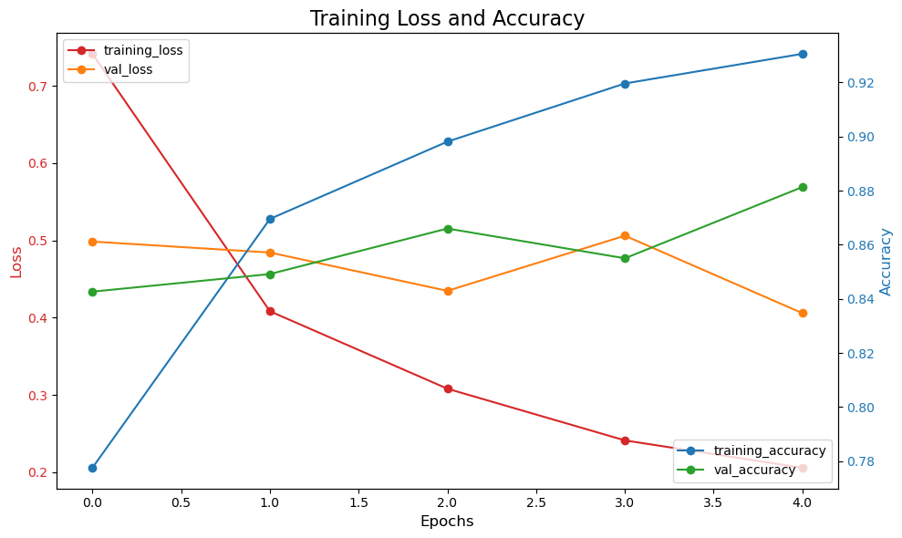
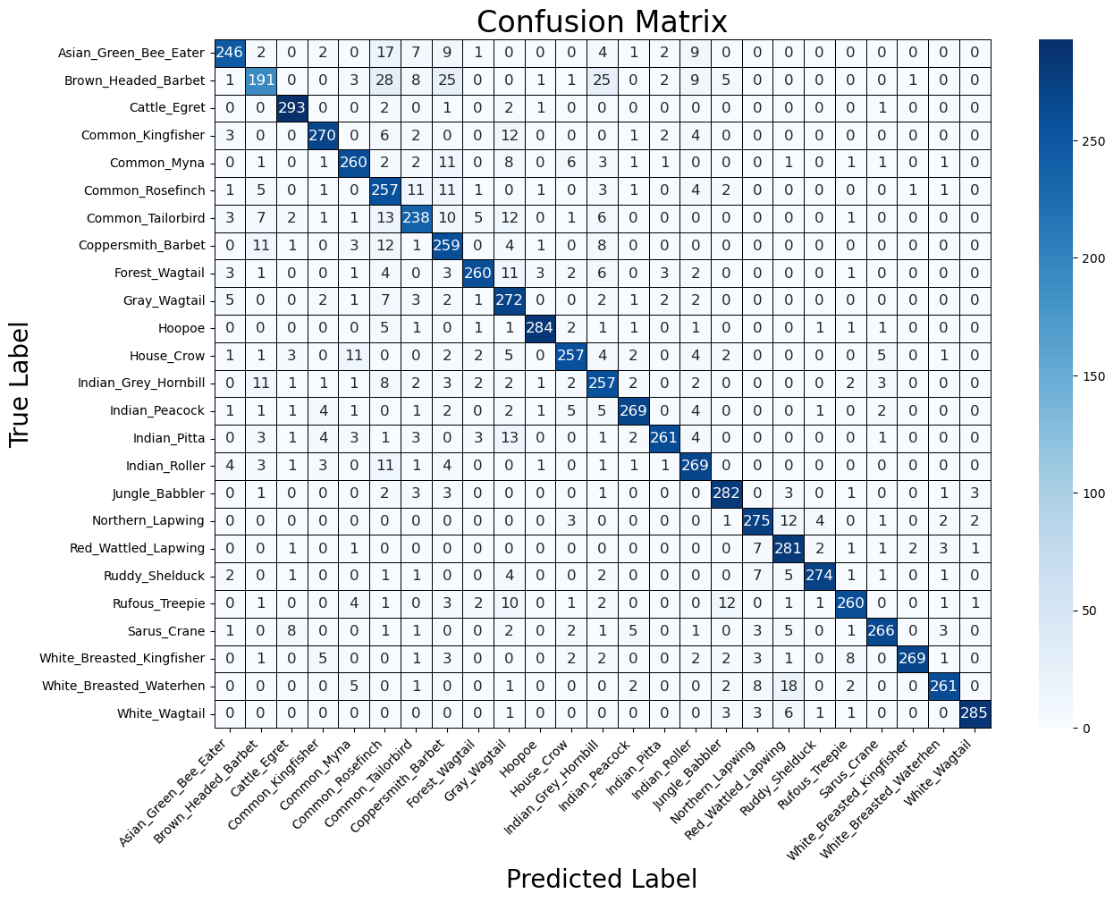
Results
ResNet50

Slide 8
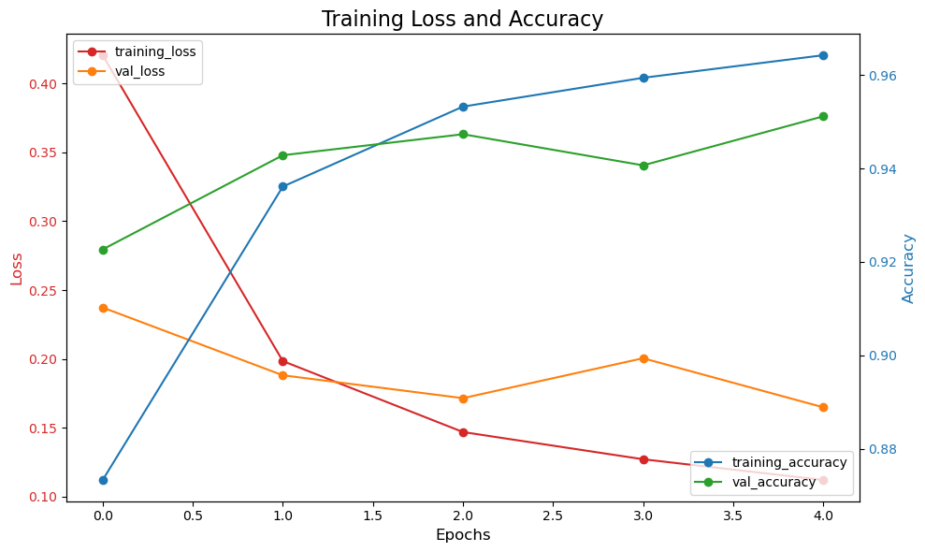
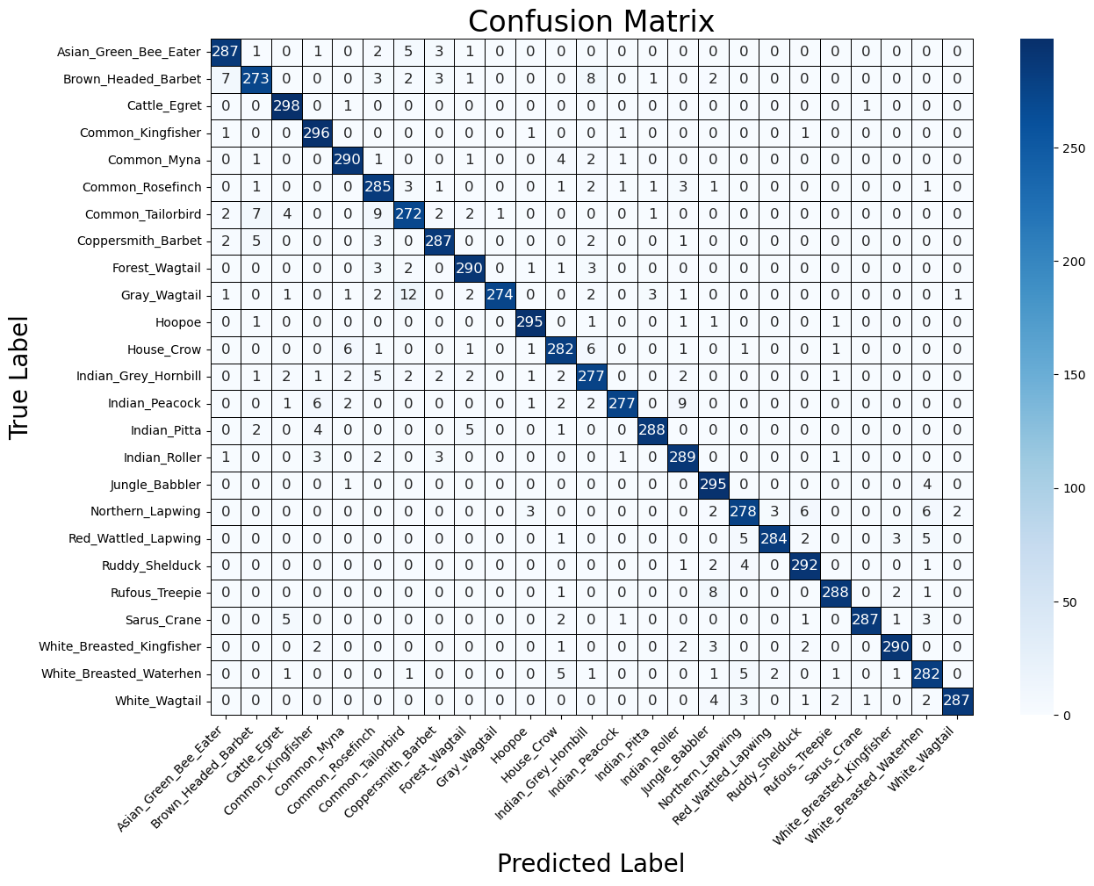
Results
EfficientNet V2

Slide 9
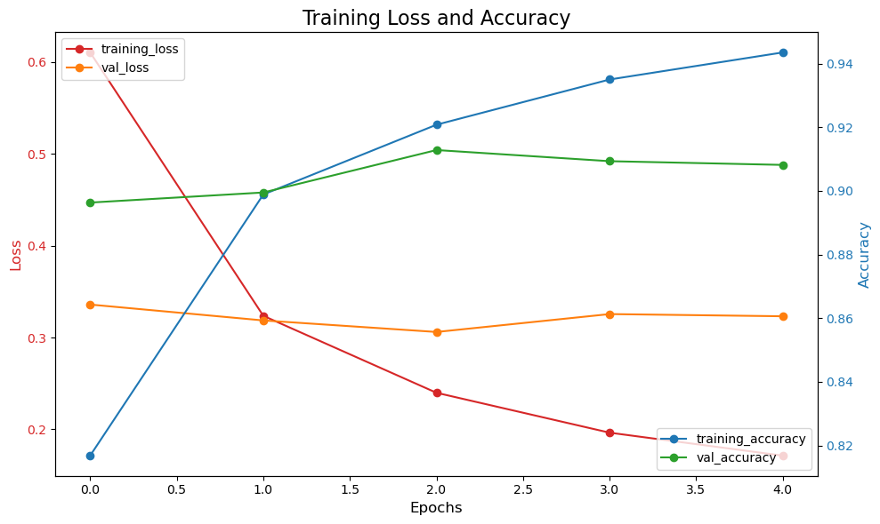
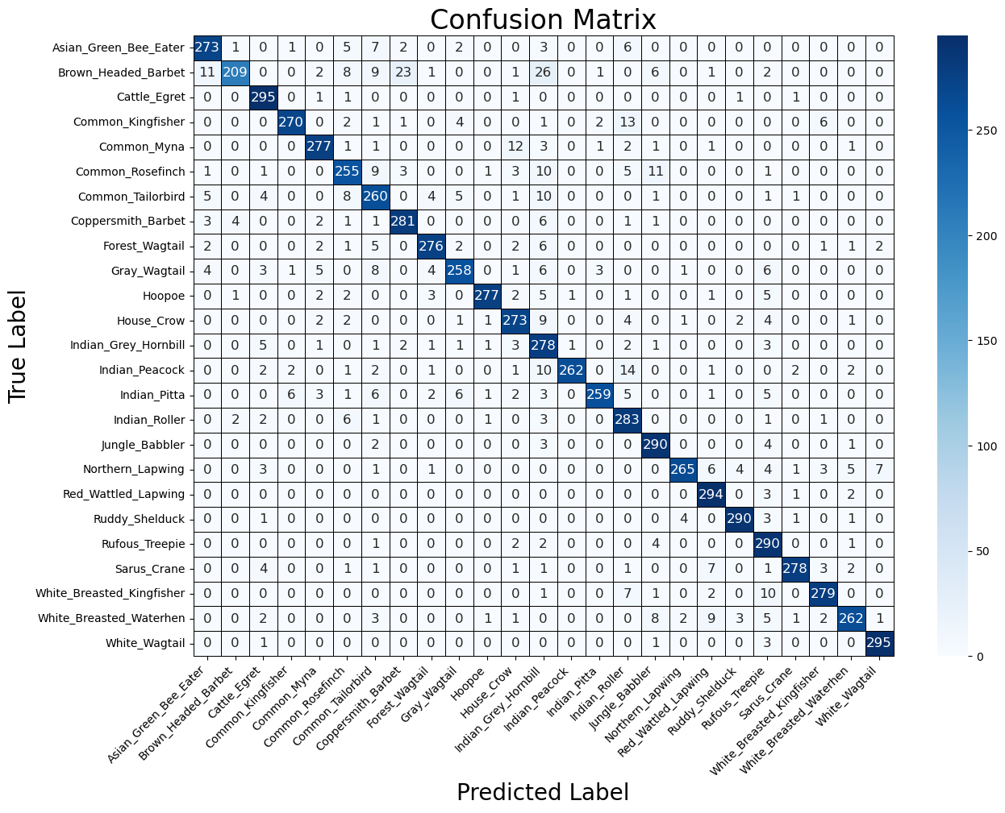
Results
MobileNet V2

Slide 10
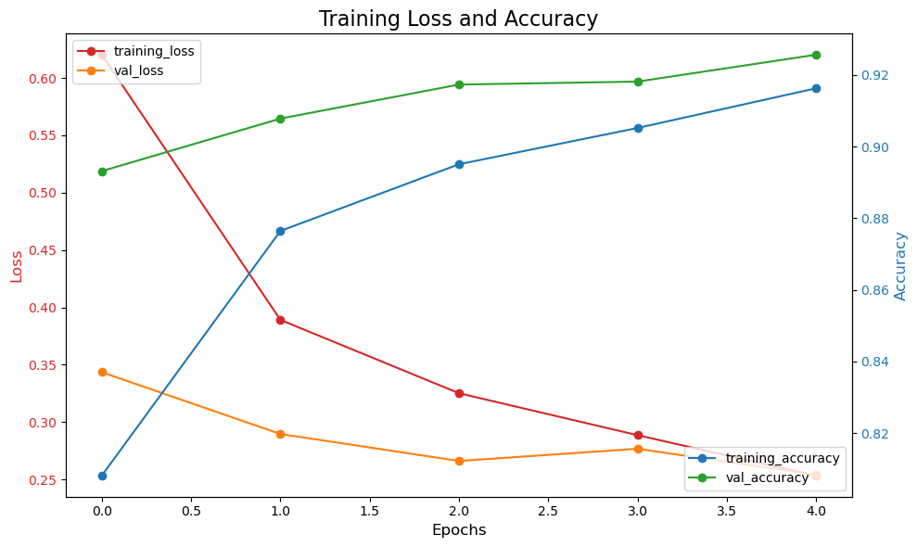

Results
ViT B32

Slide 11
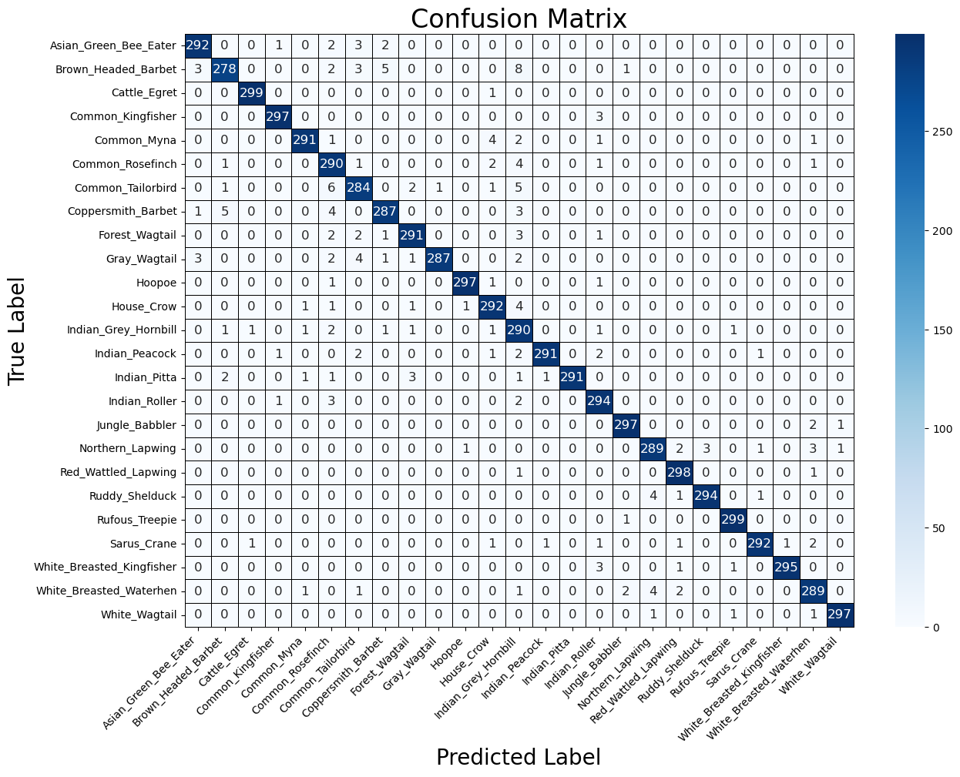
Results
Geometric Mean Ensemble

Slide 12
Results
Model | Accuracy Score | Top_3_accuracy | Precision_score | Recall_score | F1_score | Matthews_corrcoef
ResNet 50 | 0.8795 | 0.9655 | 0.8853 | 0.8795 | 0.8803 | 0.8746
Effiecient Net V2 | 0.9524 | 0.9885 | 0.9531 | 0.9524 | 0.9524 | 0.9504
Mobile Net V2 | 0.9105 | 0.9771 | 0.9161 | 0.9105 | 0.9108 | 0.9070
ViT B32 | 0.9213 | 0.9819 | 0.9230 | 0.9213 | 0.9215 | 0.9181
Ensemble | 0.9735 | 0.9940 | 0.9741 | 0.9735 | 0.9736 | 0.9724

Slide 13
Analysis
EfficientNetV2 gives better accuracy than ResNet50 even with lesser parameters.
EfficientNet also outperformed ViT-b32.
Ensemble gives the best accuracy with the highest Mathews Correlation Coefficient (MCC) so it will also generalize to unseen samples.

Slide 14
Team Contribution
Arijeet: Trained VisionTransformer and Ensemble Model
Tejas: Setting up pipeline and Augmenting images
Pragathi: Trained Resnet50, EffiecientNet and MobileNet
Sejal: Hyperparameter tuning and predictions

Slide 15
Conclusion
The Indian-Birds-Spices-Image-Classification dataset which contains 25 species of birds was selected, analyzed, and preprocessed. It was eventually used to train the proposed model. The optimal architecture of the model was also built using the transfer learning approach.
As future research, it would be important to optimize the proposed algorithm in order to accelerate model training and the possibility of obtaining a real-time solution.

Slide 16
Thank You

